Slide 1



IOT BASED APPLIENCES CONTROL THROUGH VOICE COMMEND
MINOR PROJECT-1
BY
MIDHUN.R .V
KAVINESH. A.S
MOHAMED ANAS. S
GUIDED BY
Mr.L.RAMESH

Slide 2
LIST OF CONTENT
Abstract
Introduction
Proposed method
Components method
References
M.Kumarasamy college of Engineering

Slide 3
ABSTRACT
Internet of things (IOT) is formulated to remotely connect, access, monitor and control the existent world entities through the internet.
When the iot is conceptualized towards home, it converts simple home to smart home which is safer and automated.
They will also be provided with the information regarding and they can also turn on the appliances for specific period of time

Slide 4
INTRODUCTION
Internet of things (IOT) is currently an emerging technology spread globally. IOT has stepped in various fields.
There is an increasing demand for smart homes, where appliances react automatically to changing environmental conditions and can be controlled device.
The appliances control through the voice commend.

Slide 5
PROPOSED METHOD
The application input is provided by the user using the google assistant through his mobile phone.
Using this Application the users can schedule the devices connected to Arduino and ESP8266.

Slide 6
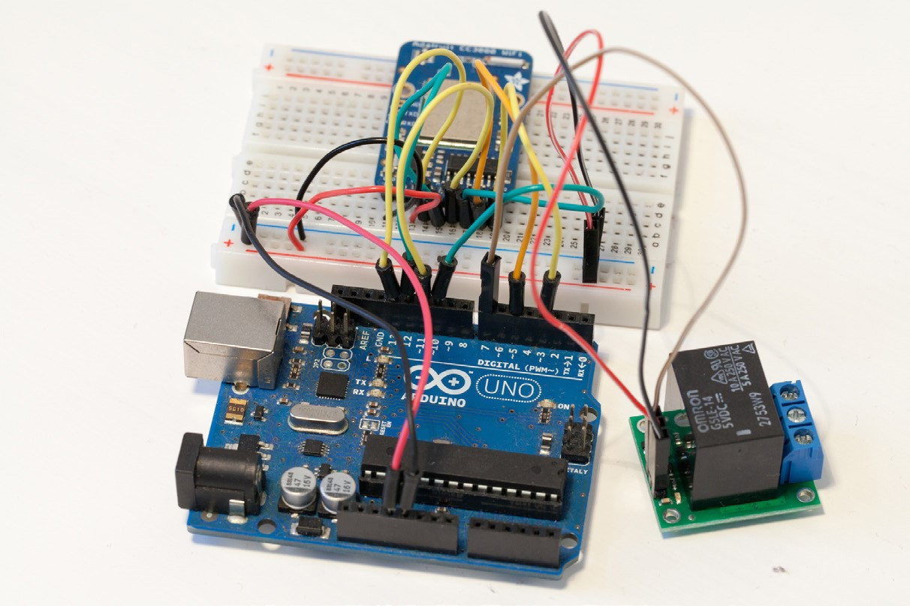
BLOCK DIAGRAM

Slide 7
COMPONENTS METHOD
Arduino uno R3
Polulu 5V relay
CC3000 wi-fi module
Breadboard
Jumper wires

Slide 8
REFERENCES
Shaik Naseera, Anurag Sachan and G. K. Rajini, "Design of smart home using internet of things" in Artificial Intelligence and Evolutionary Computations in Engineering Systems, Singapore:Springer, pp.
In the system, a microcontroller (node MCU ESP8266) takes input from the user device and sends a signal to the appropriate relay for turning on/off electrical appliances linked to the system, such as lighting, fans, and air conditioner

Slide 9


